Slide 1
The Neuromuscular Junction
MMHS
Anatomy and Physiology

Slide 3
NMJ General Information
Muscles move (contract) in response to a stimulus→ nerve impulse from a motor neuron.
One motor neuron may stimulate a few muscle cells or hundreds of them depending on the force required.
When the axon of a neuron reaches the muscle, it branches into a number of axon terminals which forms junctions called neuro-muscular junction (nmj).
The nerve and muscle don’t actually touch because there is a space b/w them called the synapse.

Slide 5
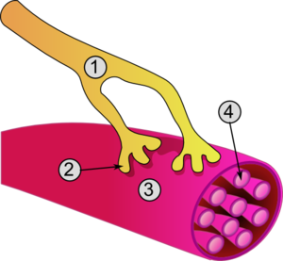
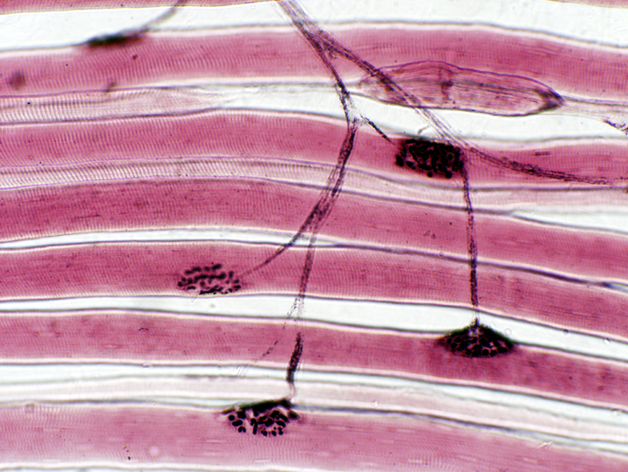
1. Axon of motor neuron 2. Motor end-plate 3. Muscle fiber 4. Myofibril

Slide 6
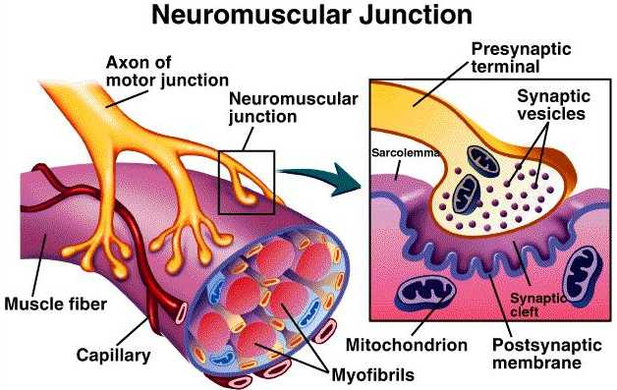

Slide 7
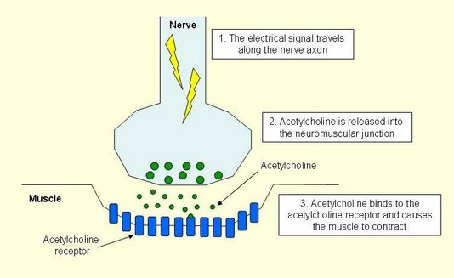

Slide 8
The Presynaptic Terminal (Nerve)
When the impulse reaches the axon terminal (end of motor neuron), it stimulates vesicles to migrate towards the membrane.
When vesicles merge with the membrane, they release their neurotransmitters into the synapse.
NT’s, like Acetylcholine (Ach)diffuse across the synaptic gap, then bind to the receptor sites.

Slide 9
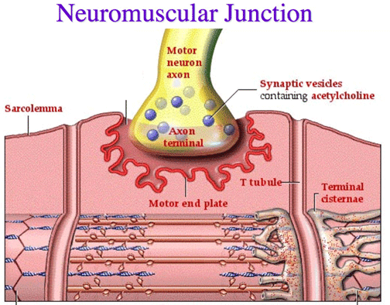

Slide 10
The Postsynaptic Terminal (Muscle)
4. When Ach docks at the receptor sites, this initiates depolarization of the membrane.
Depolarization causes sodium ions to rush into the sarcolemma and potassium ions to rush out of the membrane.
This ion movement causes the membrane interior now to be positively charged and the exterior negative charge.
This polarity reversal generates an electrical current called the Action Potential.
The action potential moves over the surface of the membrane causing the skeletal muscle to contract.

Slide 11
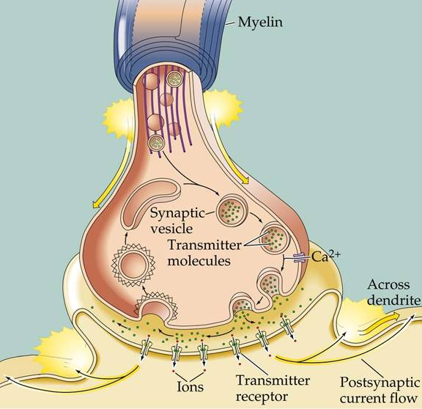

Slide 12
Changes in the Synapse
Once the action potential has started, acetylcholine in the synapse is broken down.
Ach broken down by an enzyme called Acetylcholineinterase (AchE).
This breakdown prevents continued contraction of the muscle.
The Ach parts then diffuse back into the presynaptic terminal and are reassembled by the Rough Endoplasmic Reticulum into new neurotransmitters.

Slide 13
